Slide 1
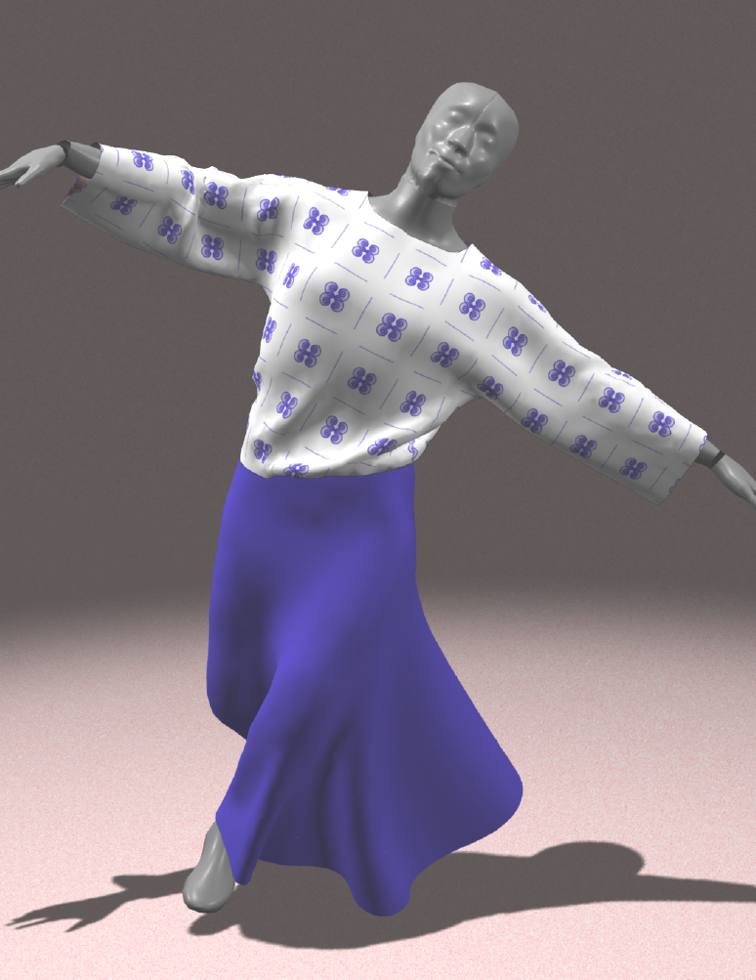
Cloth Animation

Slide 2
Outline
Overview
Cloth Modeling
Static model
Dynamic model

Slide 3
Why cloth simulation?
High demands from
Character animation
Game industry
Fashion industry
Textile industry

Slide 4
Challenges of Cloth Simulation
Realistic cloth
Interactive cloth
Stable cloth
Complex cloth
Collision detection/handling

Slide 5
Cloth Modeling
Textile Engineering
measuring mechanical properties
CAD/CAM and industrial applications
Computer Graphics
Simulating the complex shapes and deformations of fabric and clothing
Geometric approaches
Physically-based approaches
Notes:
The textile community views cloth as an engineering material.

Slide 6
The Drapemeter (1950)
Used to quantify draping behavior
Drape factor
Number of folds
cloth

Slide 7
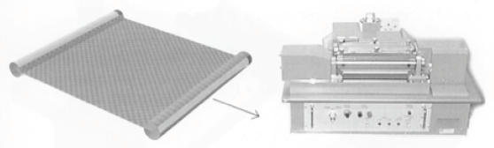
Kawabata System (1973)
Measure the mechanical properties of cloth
Bending, shearing, tensile, compression, etc.
Volino and Magnenat-Thalmann, “Virtual Clothing”

Slide 8
CG Cloth Modeling
Geometric approaches
Weil (1986)
Continuum approaches
Feynman (1986) - minimize strain energy
Terzopoulos et al. (1987) - elasticity-based forces
Thalmanns (1990 on) – virtual clothing

Slide 9
CG Cloth Modeling (cont.)
Particle-based approaches
Haumann (1987) - Mass-spring model
Breen et al. (1991-94) - Particle-based model
Baraff & Witkin (SIGGRAPH’98) - Implicit integration
Misc.
Eberhardt et al. (1995) - Modeling knits
Ko & Choi (SIGGRAPH’02) - Buckling model
Goldenthal et al. (SIGGRAPH’07) - Lagrangian mechanics
Kaldor, James, Marschner (SIGGRAPH’08) - yarn level

Slide 10
Continuum Approaches

Slide 11
Continuum Approaches
Modeling cloth with continuum physics
Discretize object
Calculate forces
Integrate forces
Based on elasticity theory
Based on finite-element method
Not commonly used in practice

Slide 12
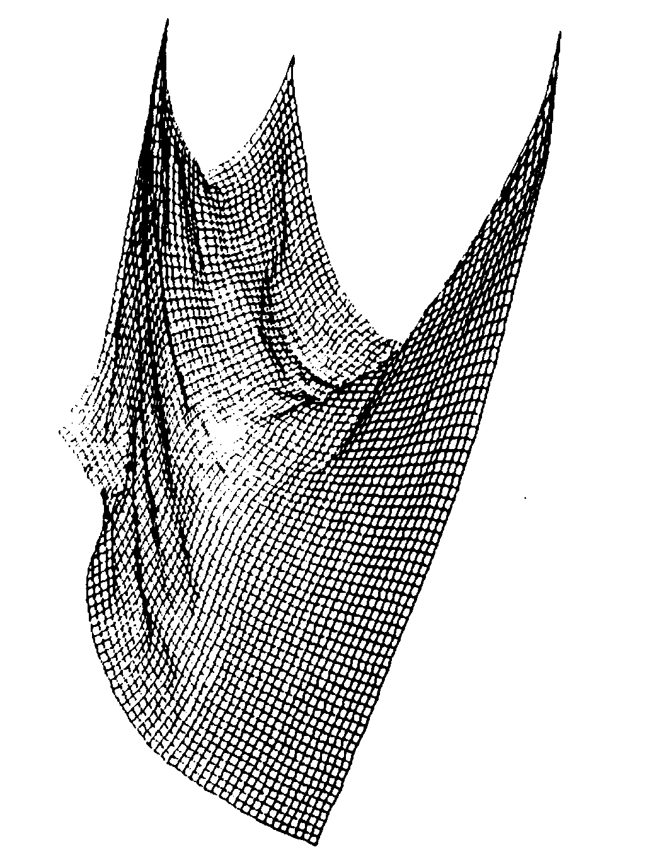
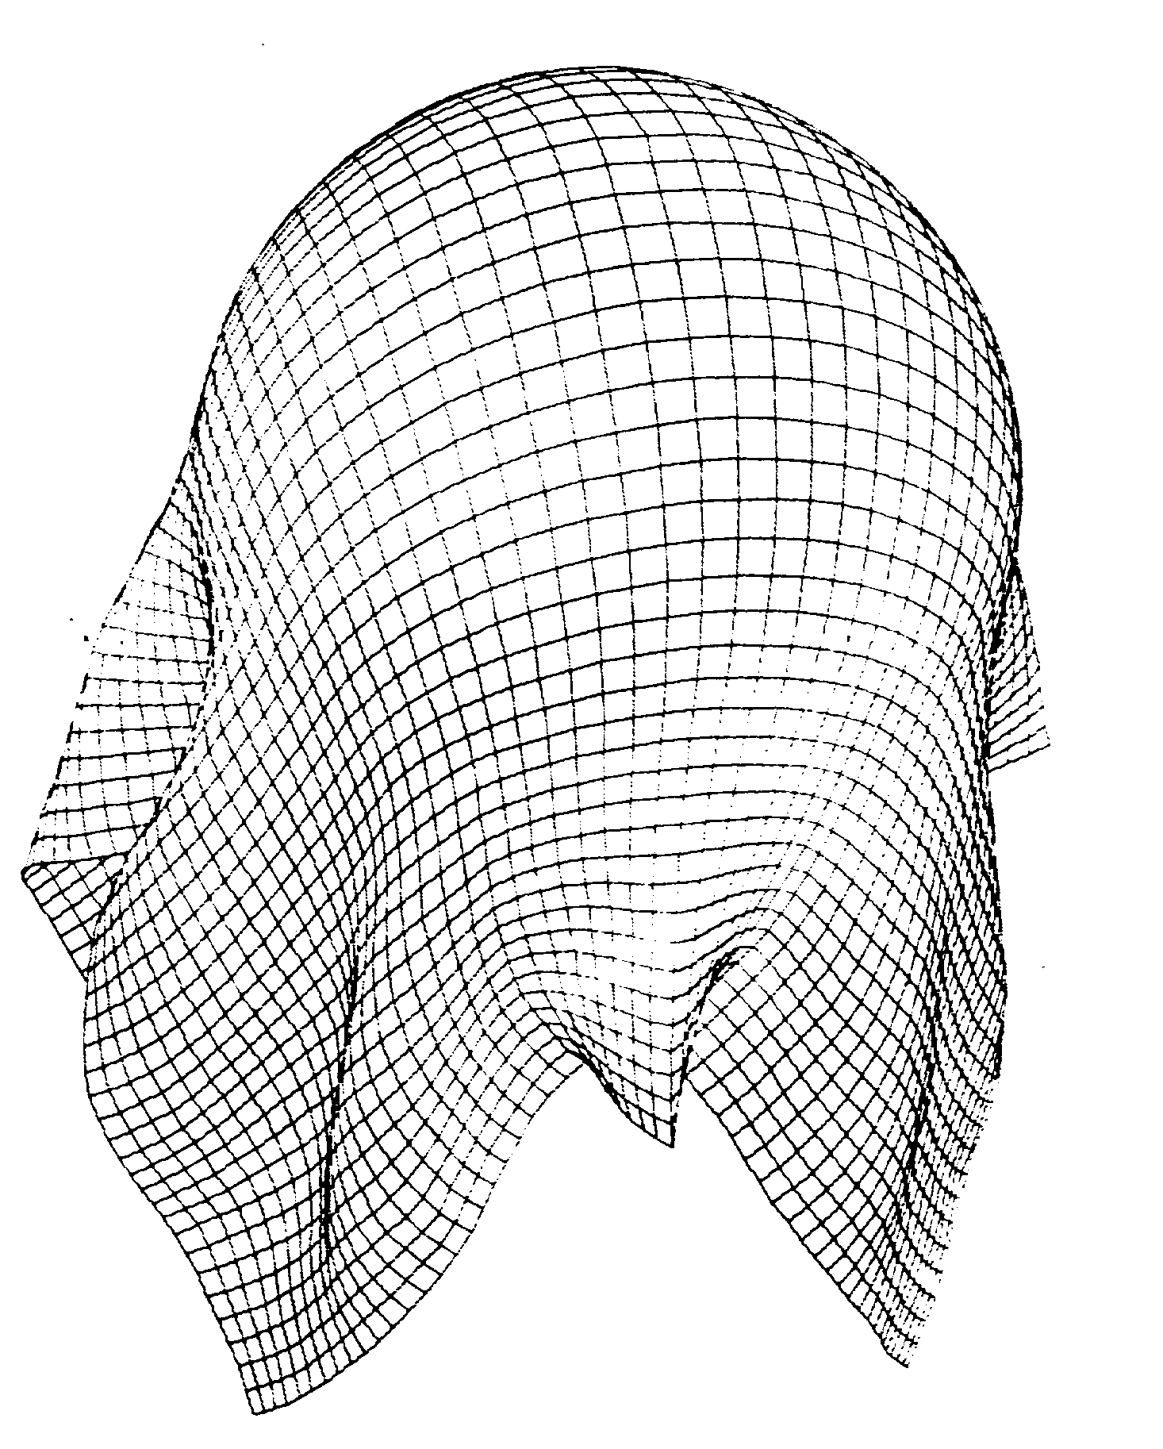
Feynman (1986)
Predicts cloth deformation by minimizing
Strain energy
Bending energy
Very “stretchy” cloth
Notes:
Distance constraint between neighboring points does not hold

Slide 13
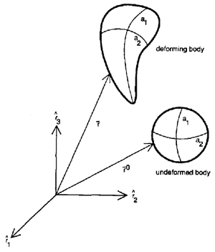
Terzopoulos et al. (1987)
Based on elasticity theory & differential geometry
Simplified dynamics
Elastic deformation
Inelastic deformation
Fracture
distance & angle
curvature

Slide 14
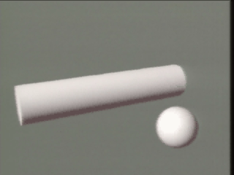
Terzopoulos et al. Results

Slide 15
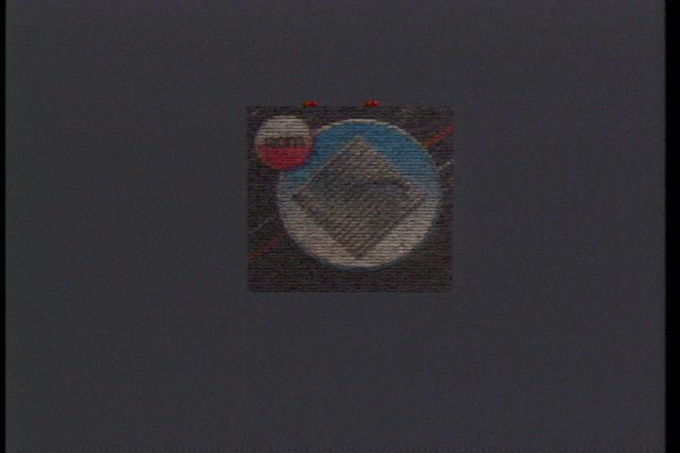
Terzopoulos et al. Results

Slide 16
Thalmann (1990 - Present)
Extend Terzopoulos model
Enhanced computational techniques
Collision detection and response
Designing a complete set of clothing
User interface
Data structures
Focused on clothing virtual actors

Slide 17
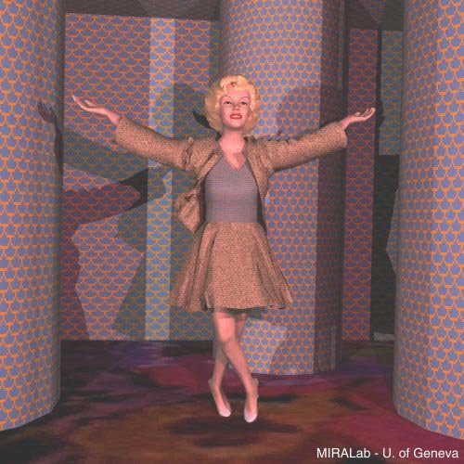

Thalmann et al. Results

Slide 18
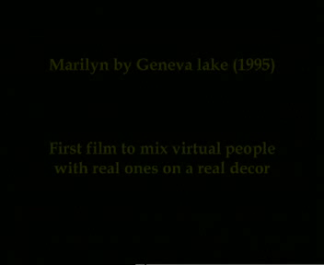
Thalmann et al. Results (1995)

Slide 19
Thalmann et al. Results (2005)
La Haute Couture Mise en Equations

Slide 20
Particle-based Approaches

Slide 21
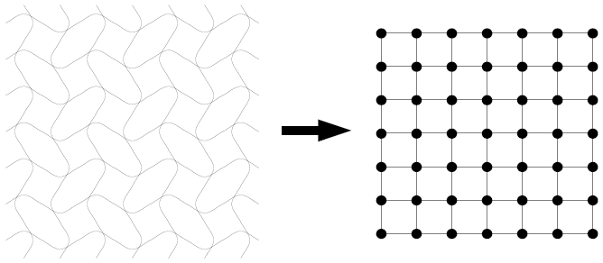
Particle-based Approaches
Breen, House, Getto, Wozny, 1992-1994
Macroscopic behavior arises from modeling microscopic structure
Particles based on thread-level interactions
Breen et al. “A physically-based particle model of woven cloth,” 1992

Slide 22
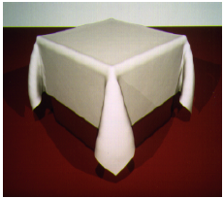
Breen et al.(1994) – statics
Energy-based model
Compute final draping configuration by minimizing the total energy in the cloth
Notes:
Statics: static equilibrium

Slide 23
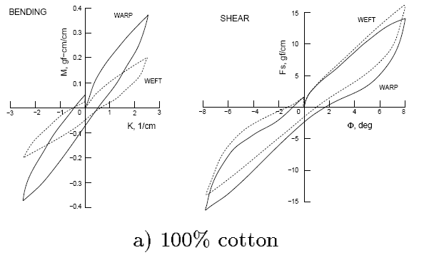
Breen et al.(1994)
Tries to make the drape more realistic by measuring from the reality (Kawabata system)
Fit functions to the measured data
No dynamics involved
Bending Tester
Shearing Tester
Notes:
紡織
Warp means 經線
Weft means 緯線

Slide 24
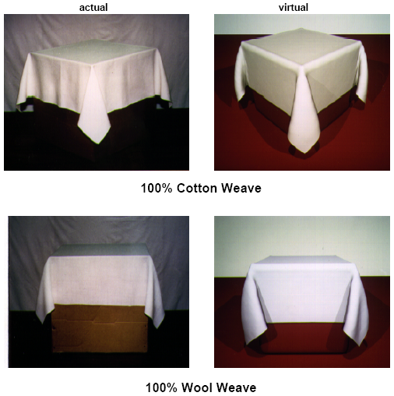
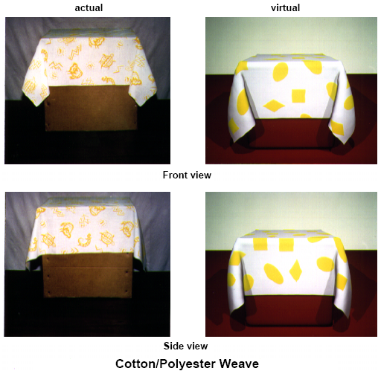
Breen et al. Results

Slide 25
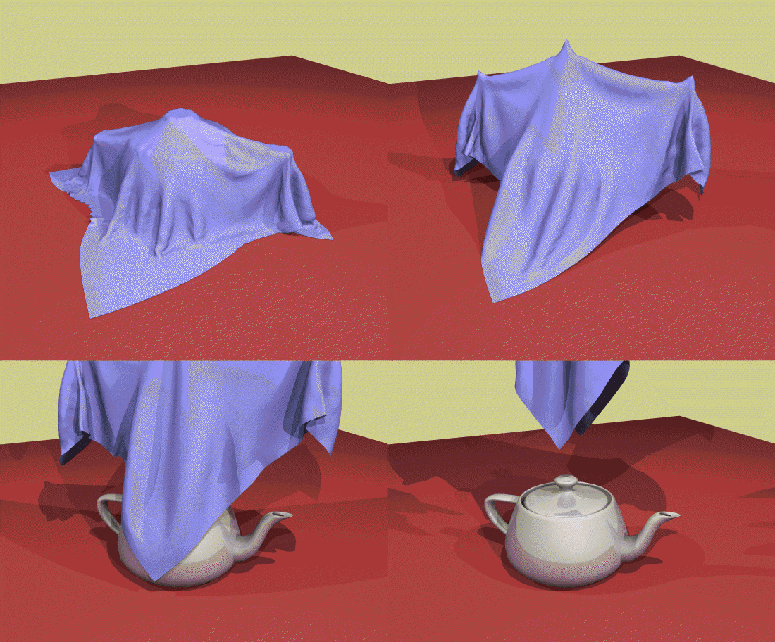
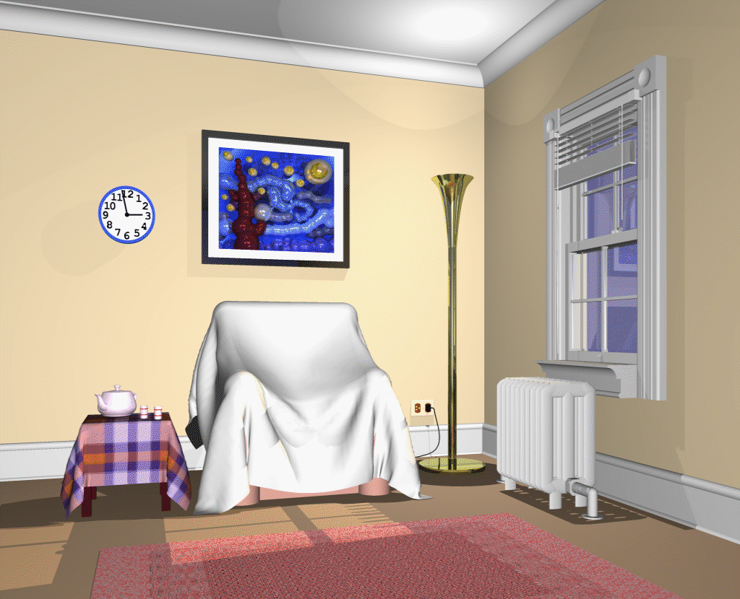
Breen et al. Results

Slide 26
Extend to include dynamics
Add cloth springs to model
Stretch
Shearing
Bending
separation spring
(nonlinear forces)
trellising spring
(nonlinear torques)
bending spring
(nonlinear torques)

Slide 27
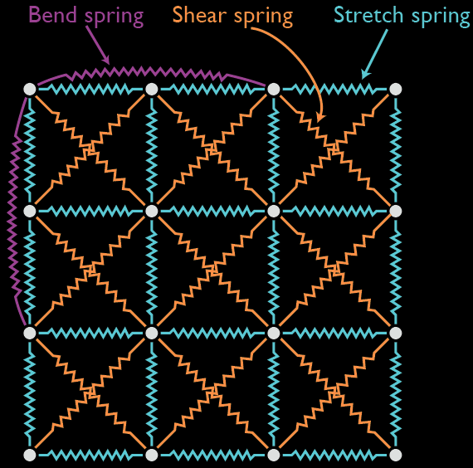
Mass-spring Model
A simple spring-damper system due to Provot (1995)
Courtesy of Chris Twigg

Slide 28
Baraff and Witkin (1998)
“Large steps in cloth simulation” SIGGRAPH’98
Rapid cloth simulation with implicit integration
Larger time steps and faster simulations
Triangle-based representation
Exploit sparseness of Jacobian
Used in Maya Cloth

Slide 29
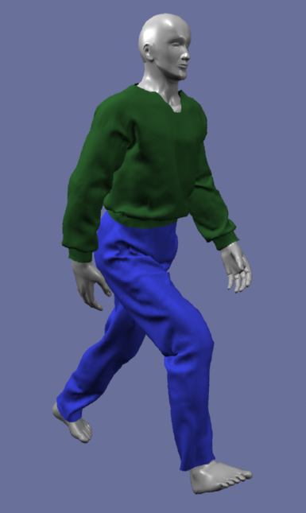
Baraff and Witkin Results

Slide 30
Newton’s 2nd Law of Motion
n particles
Diagonal matrix

Slide 31
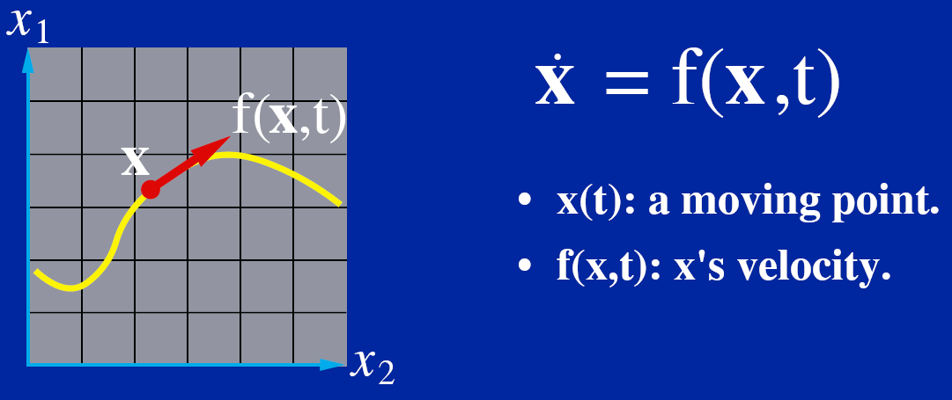
Different Equation Basics (review)

Slide 32
Explicit Euler (review)

Slide 33
Implicit Euler
Implicit formula for
Usually no close form solution for a nonlinear equation

Slide 34
Approximation using Taylor Series
Recall that a Taylor series of a real function in two variables is given by
We can approximate f(x,v) as
matrix
vector
Notes:
partial_f/partial_x is a matrix evaluated at (x0, v0)

Slide 35
Approximation using Taylor Series
Plug the first row into the second row, we can get:

Slide 36
Solving the Implicit Integration
To solve for , we need to compute
Easy for few springs/dampers
Difficult for a complex model
Compute forces from a potential energy function
Damping force cannot be derived!
An inaccurate but useful interpretation:
Consider work generated by an external force,
For potential energy by internal force,

Slide 37
Solving the Implicit Integration
To solve for , we need to compute
Compute forces from a special energy function
scalar
vector condition we want to be zero
Notes:
These are the original equations listed in the paper, but there seems to be some minor mistakes. See the following slide.

Slide 38
Solving the Implicit Integration
To solve for , we need to compute
Compute forces from a special energy function
scalar
vector condition we want to be zero
Notes:
Starting from this vector-based energy description tends to result in a simpler, more compact, and more easily coded formulation for partial_f/partial_x
C(x) is usually a sparse matrix in which each block depends on few particles.
Partial_C/partial_x is a Jacobian matrix.

Slide 39
Solving the Implicit Integration
To solve for , we need to compute
Compute forces from a special energy function
scalar
Notes:
Starting from this vector-based energy description tends to result in a simpler, more compact, and more easily coded formulation for partial_f/partial_x
C(x) is usually a sparse matrix in which each block depends on few particles

Slide 40
Triangle-based Cloth Model
Particles are linked like a triangular mesh
Energy defined over finite regions
How do we determine stretch and shear on triangles?

Slide 41
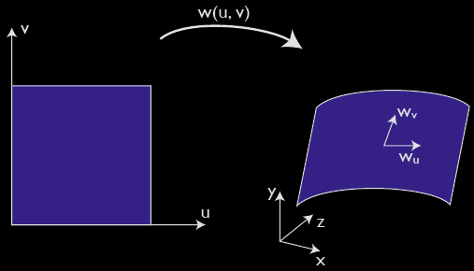
Basic Idea
Represent cloth surface as a triangular surface embedded in 3D
Locally linear mapping w(u,v)
Measure deformation using
Texture coordinate (planar)
World space (3-D surface)
Courtesy of Chris Twigg

Slide 42
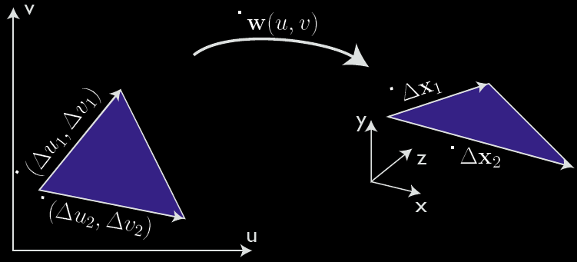
Stretch/Compression Measure
Represent (△x, △y, △z) using (△u, △v)
Again, we’ll use Taylor series!

Slide 43
The Jacobian is formed by
With locally linear assumption,
Fixed value during simulation

Slide 44
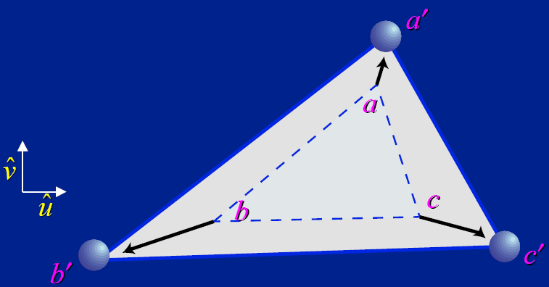
Forces as Energy Functions
Condition for stretch forces
rest length
triangle’s area in uv coordinate
Deformation in world space =
Area_uv * Deformation_uv

Slide 45
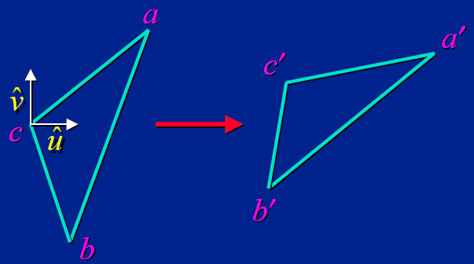
Shear Forces
measured by the inner product

Slide 46
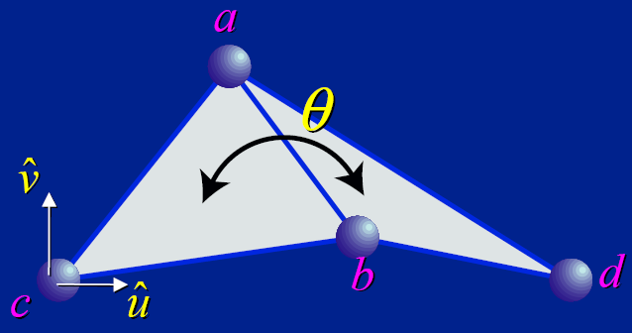
Bending Forces

Slide 47
Damping Forces
Important both for realism and numerical stability
Instead of deriving from E,
Baraff and Witkin differentiate C
Act in direction of corresponding elastic force
Proportional to the velocity in that direction
Gradient of E = 0 when E is at its minimum→ damping force is always zero at the rest state!
velocity
direction of force
Notes:
E is a potential energy function
From dE/dt, the damping force would be zero at the rest position. This is not what we want as at the rest position, the kinetic energy is usually at its maximum!

Slide 48
Constraints
May choose
penalty method → stiff system
Lagrange multipliers → need compute constraint force
Parametric constraint (reduced coordinate) → infeasible for dynamic contact constraints
Baraff & Witkin introduced a new approach by modifying mass matrix

Slide 49
Zero-acceleration Constraints
Basic idea: Enforcing constraints by mass modification
e.g. zero acceleration along z-axis

Slide 50
Non-axis zero acceleration constraints
For the ith particle
Notes:
Try f_i = k p_i → xi” = (I-pi *pi’)kpi=0, zero acceleration along pi

Slide 51
Verification
Consider
Particle i is constrained to be moved perpendicular to P_{i}

Slide 52
Arbitrary Velocity Constraints
No constraints
With constraints
Mass-modified matrix for constraints
Arbitrary velocity constrain

Slide 53
Higher-order implicit methods
Implicit Euler has only first-order accuracy
2nd-order implicit method is used in
Ko & Choi, SIGGRAPH’02
Bridson, Marino, & Fedkiw, SCA’03 (mixed explicit / implicit method)

Slide 54
Miscellaneous Approaches

Slide 55
Eberhardt et al. (1995)
Focus on knits, instead of woven cloth
Particle system with measured energies
Volumetric approach to rendering knits
Represent microstructure
Sweep density distributions along yarns

Slide 56
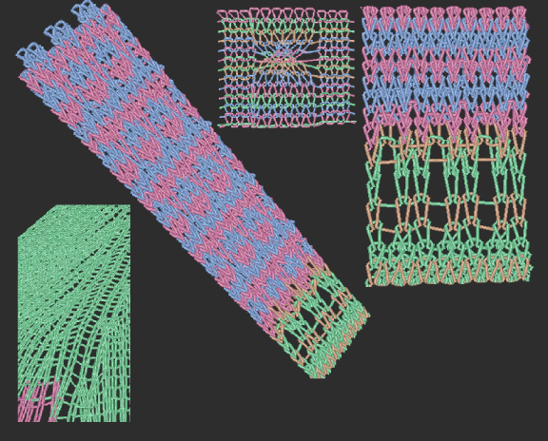
Eberhardt et al. Results

Slide 57
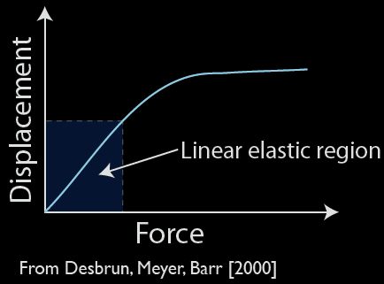
Avoiding Stiffness
Apply only non-stiff spring forces and then “fix” the solution at the end of time step
Provot (1995)
Desbrun et al. (1999)
Bridson et al. (2002)
Popular for interactive applications

Slide 58
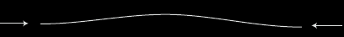

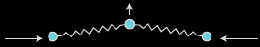
Ko, Choi (SIGGRAPH 2002)
Cloth property
Weak resistance to bending
Strong resistance to tension
Problem in spring-mass model
Stiff system for non-stretch
Need large compression forces for out-of-plane motion

Slide 59
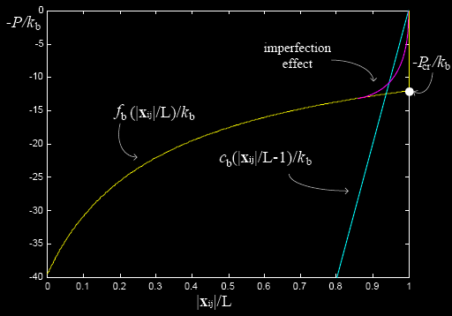
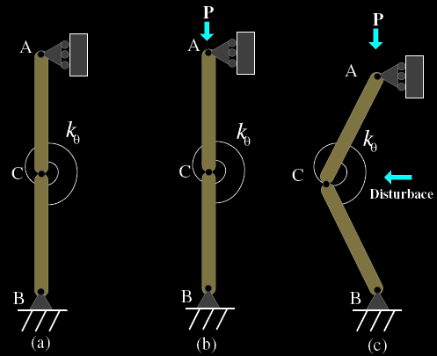
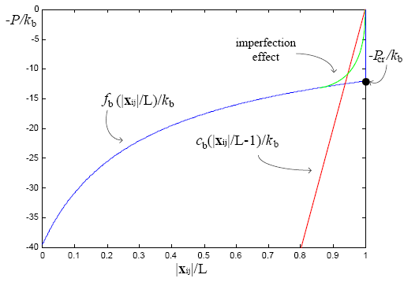
Ko, Choi (2002)
Use column buckling as their basic model
Replace bend and compression forces with a single nonlinear model
approximated
real cloth
bucking load
ideal bucking curve
column bucking
Notes:
Yellow curve

Slide 60
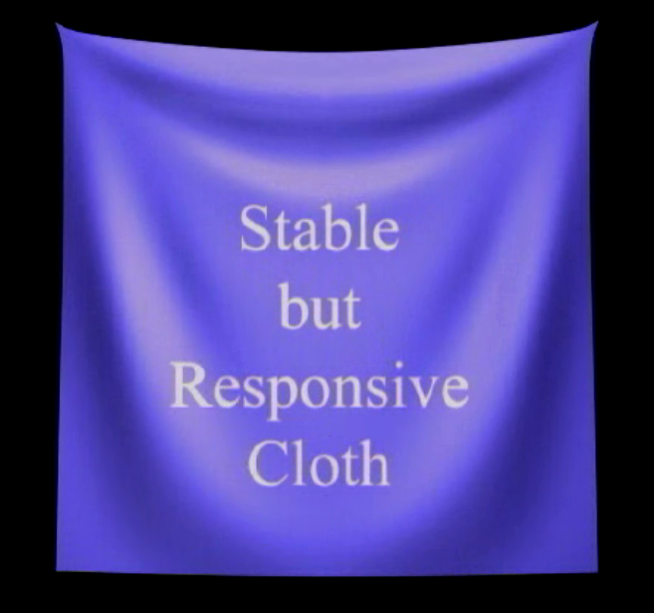
Ko and Choi results

Slide 61
Cloth Model Based on Constrained Lagrange Mechanics
Goldenthal et al., “Efficient Simulation of Inextensible Cloth,” SIGGRAPH’07
Inextensibility is important for cloth animation!
An alternative to implicit integration for stiff system—reformulate it as constraints.
Notes:
Given a stiff differential equation, an alternative to implicit integration is to reduce the stiff component and reformulate it as a constraint!
Propose a novel CLM formulation that is implicit on the constraint gradient

Slide 62
Quick Tutorial on Lagrangian Mechanics
Lagrangian mechanics is just another form of Newtonian mechanics
Newtonian mechanics describes motion in Cartesian coordinate (vector) → coordinate transformation is hard
Lagrangian mechanics describes motion via energy → coordinate transformation is easy
generalized coordinate
Notes:
http://www.physicsinsights.org/lagrange_1.html

Slide 63
Quick Tutorial on Lagrangian Mechanics
Reformulation of classical mechanics
Lagrangian of a dynamical system
The equation of motion is defined as

Slide 64
Cloth Model Based on Constrained Lagrange Mechanics
Augment Lagrange equation with constraints
Constrained dynamics equation
Constraints
Lagrange
Multipliers
Potential energy: stretch, bending, shear
Notes:
GradV is the same as f = - partialE/partialX

Slide 65
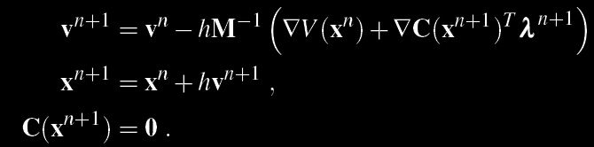
Hybrid Scheme ODE solver
Potential and constraint equations may be integrated using different explicit or implicit schemes
Implicit Constraint Direction (ICD) scheme

Slide 66
Step and Project (SAP)
Solving ICD is computationally expensive
needs to find roots of an equation of 5N variables
N is the number of vertices
Alternative
Step forward only the potential forces to unconstrained position
Enforce the constraints by projecting onto the constraint manifold , i.e., find that is close to
Notes:
Fast projection finds a manifold point, xn+1, that is close, but not
closest, to the unconstrained point, xn+1
0 . Referring to the Corollary,
we conclude that fast projection exactly solves C = 0 while it
approximates F = 0.

Slide 67
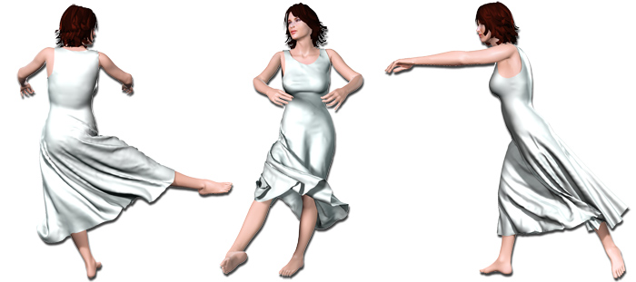
Efficient Simulation of Inextensible Cloth
Video

Slide 68
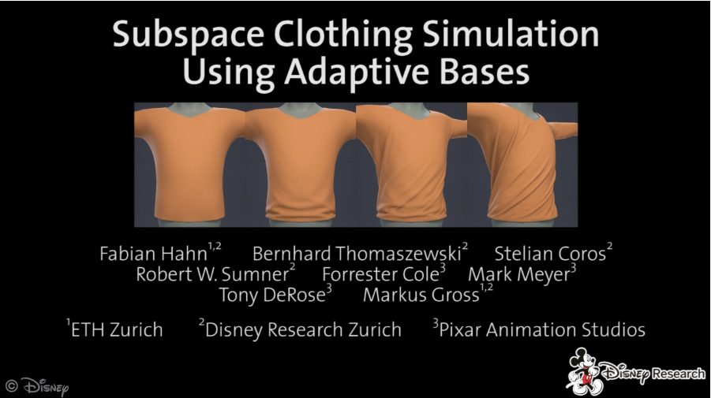
Subspace clothing simulation using adaptive bases
Siggraph 2014
Simulation using low-dimensional linear subspaces with temporally adaptive bases
Notes:
We present a new approach to clothing simulation using low-dimensional linear subspaces with temporally adaptive bases.
Our method exploits full-space simulation training data in order to construct a pool of low-dimensional bases distributed across pose space.
For this purpose, we interpret the simulation data as offsets from a kinematic deformation model that captures the global shape of clothing due to body pose.
During subspace simulation, we select low-dimensional sets of basis vectors according to the current pose of the character and the state of its clothing.
Thanks to this adaptive basis selection scheme, our method is able to reproduce diverse and detailed folding patterns with only a few basis vectors.
Our experiments demonstrate the feasibility of subspace clothing simulation and indicate its potential in terms of quality and computational efficiency.

Slide 69
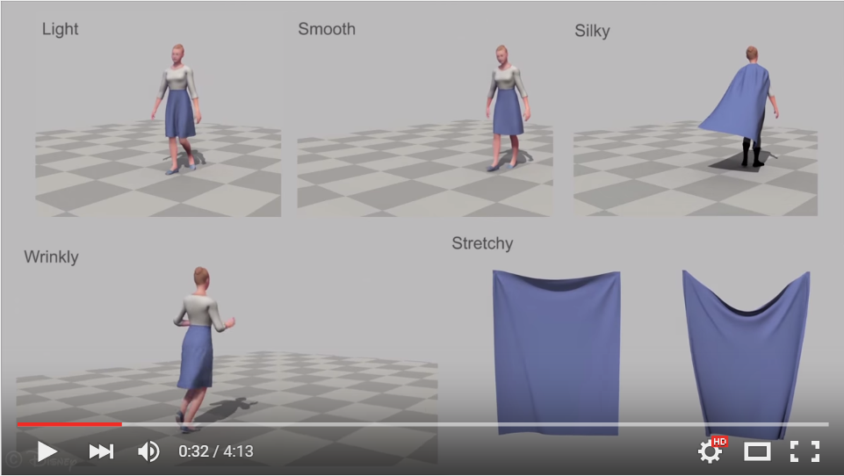
A perceptual control space for garment simulation, Siggraph 2015
Provide intuitive and art-directable control
Learned mapping from common descriptors to simulation parameters
https://youtu.be/LJ_zxvsdcrw
Notes:
We present a perceptual control space for simulation of cloth that works with any physical simulator, treating it as a black box.
The perceptual control space provides intuitive, art-directable control over the simulation behavior
based on a learned mapping from common descriptors for cloth (e.g., flowiness, softness) to the parameters of the simulation.
To learn the mapping, we perform a series of perceptual experiments in which the simulation parameters are varied and
participants assess the values of the common terms of the cloth on a scale.
A multi-dimensional sub-space regression is performed on the results to build a perceptual generative model over the simulator parameters.
We evaluate the perceptual control space by demonstrating that the generative model does in fact create simulated clothing
that is rated by participants as having the expected properties.
We also show that this perceptual control space generalizes to garments and motions not in the original experiments.

